Slide 1
Clustering of brokers
A Closer Look

Slide 2
Research Questions
Why do some brokers cluster together some of the time but not all the time?
Why do so brokers switch clusters together?

Slide 3
Method
Firms were clustered based on the sector to which they invested.
For the month of January clustering was performed each day.
The metrics were % of total investment into each sector.
Using the k-means algorithm, the firms were then grouped into 4 clusters.

Slide 4
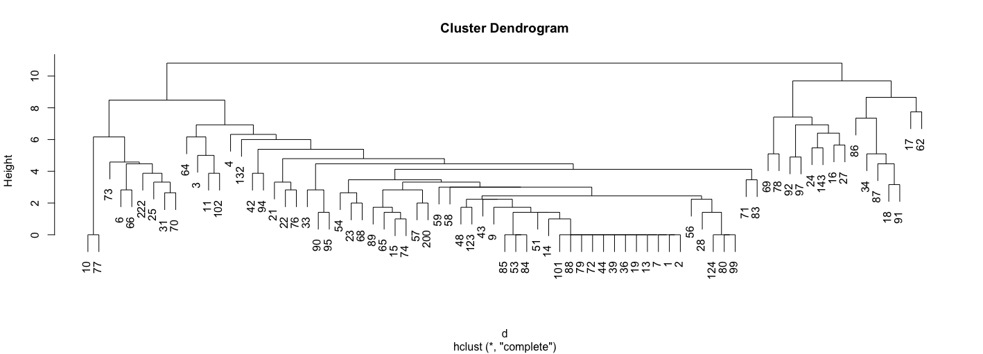
Results
The Focus will be on firms 90 & 95

Slide 5
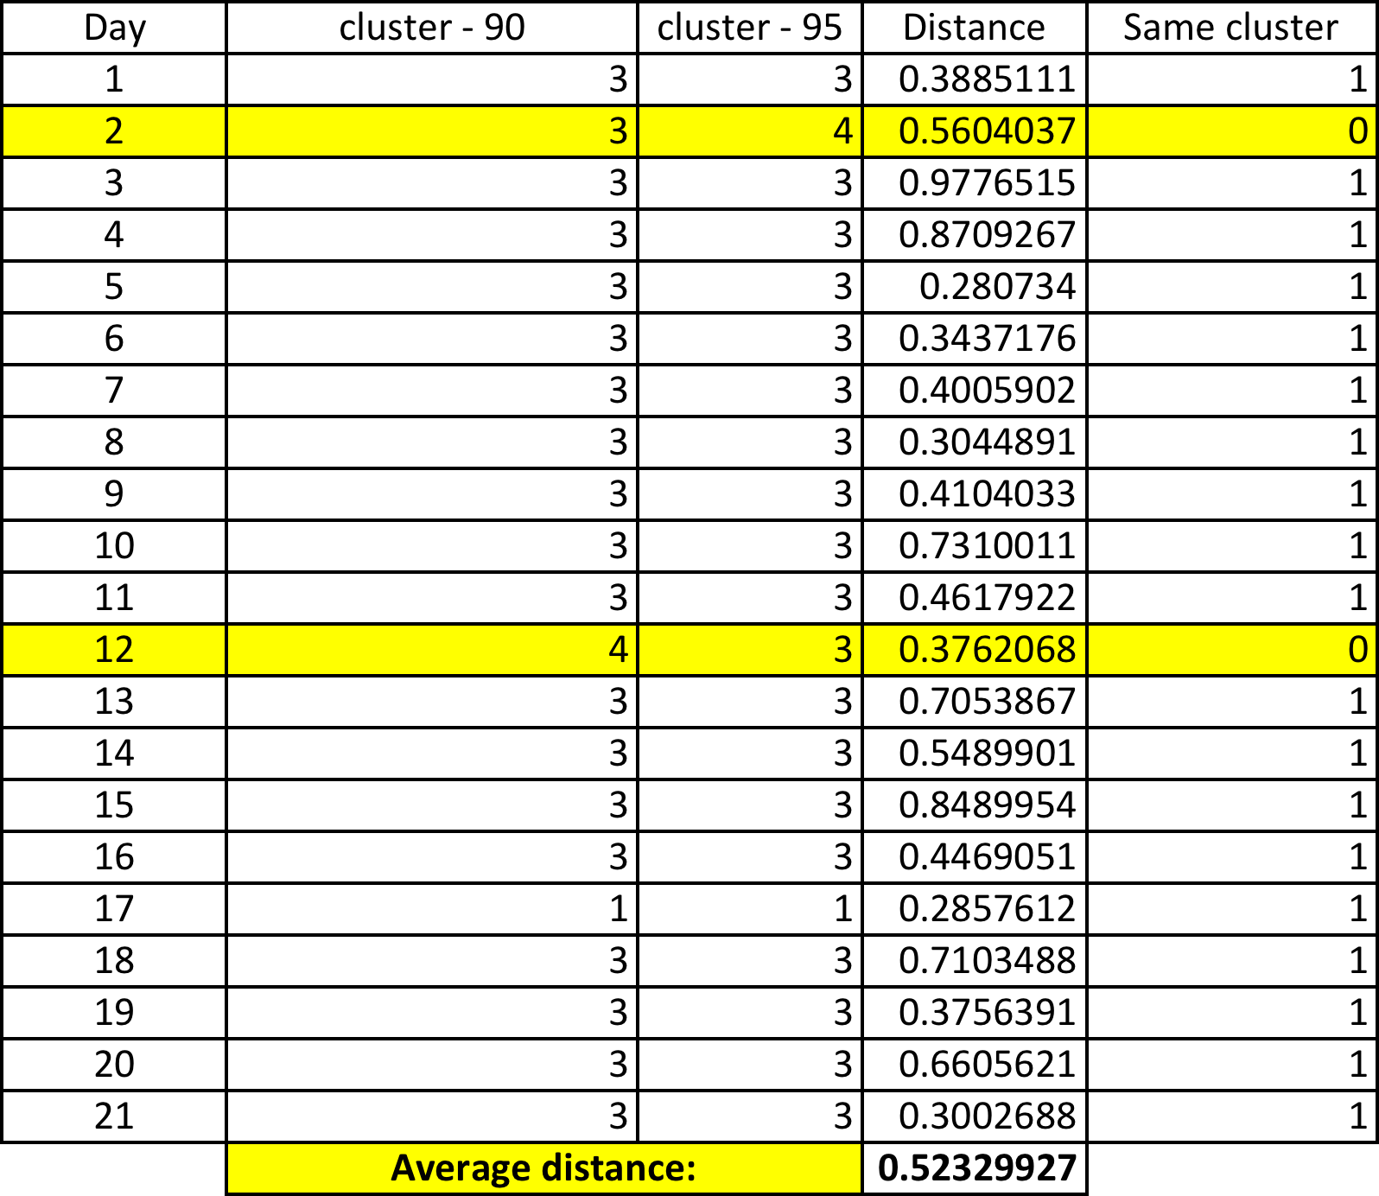
First Focus: Firms 90 & 95

Slide 6
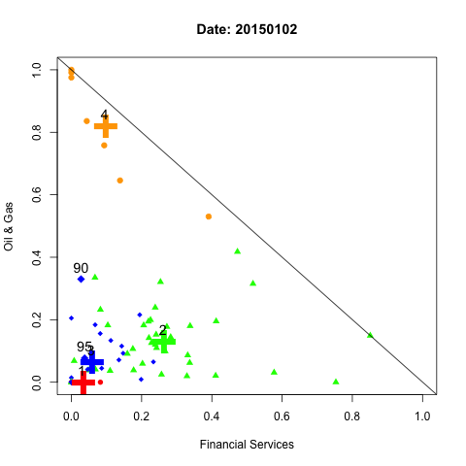
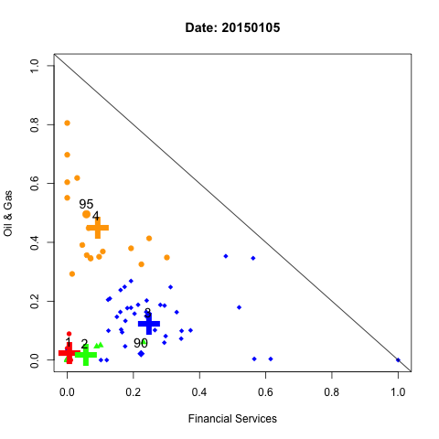
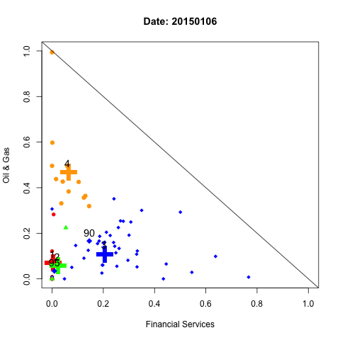
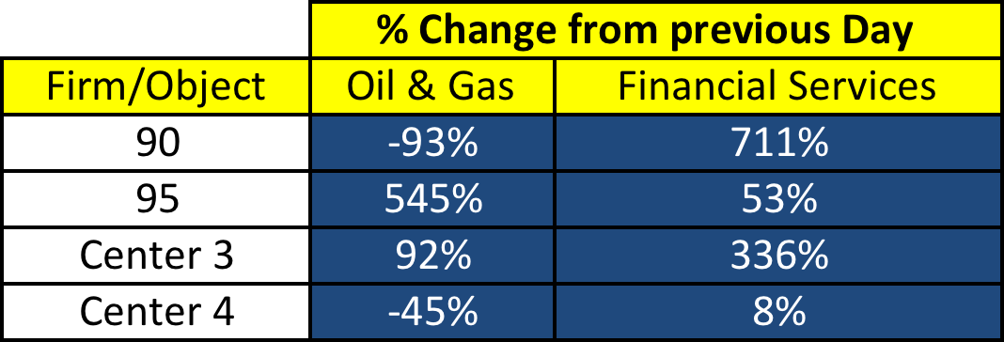
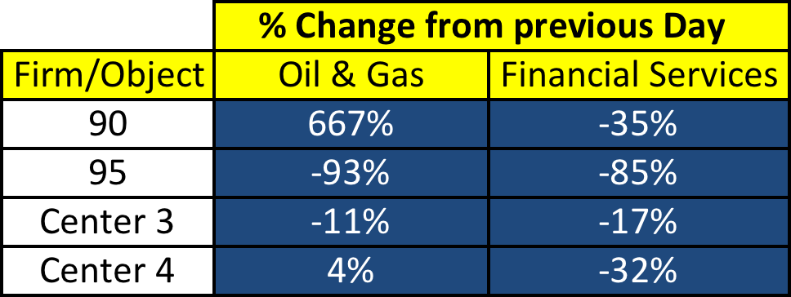
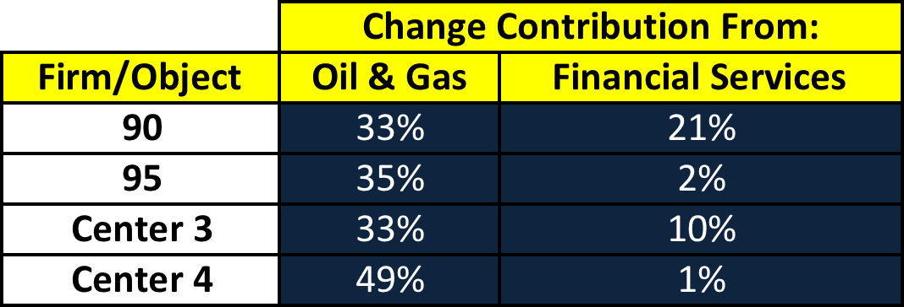
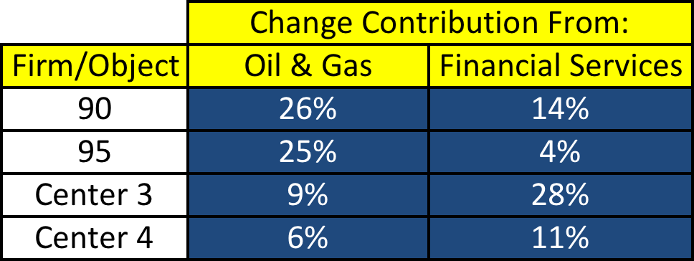
First 3 days
Distance: 0.39
Distance: 0.56
Distance: 0.97

Slide 7
(Hypothesized) Results
An abundance of media and new information was released:
‘Oil, European Inflation Rattle Markets While Euro Hits a 9-year low’
‘It was announced that U.S- Stocks Funds rose 7.6% in 2014’
Advisers’ Forecasts Shared Different Sentiments Regarding Oil & Gas
Oil opens 6% below what it opened at the previous week.
‘’ are all articles archived from the Wall Street Journal
An abundance of new information became available between January 2nd and January 5th.
Firms could have acted differently on this information, which could explain the shift in clusters.
As well, January 2nd was a banking holiday in some countries.

Slide 8
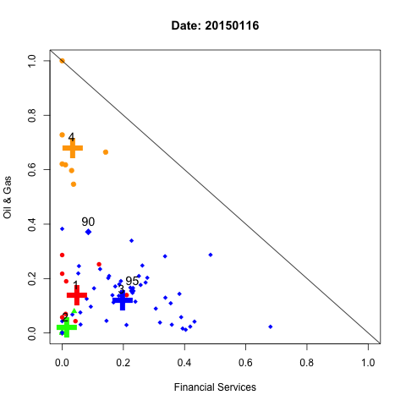
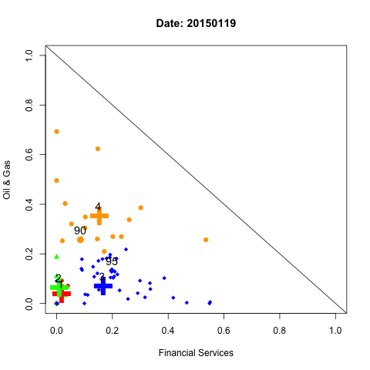
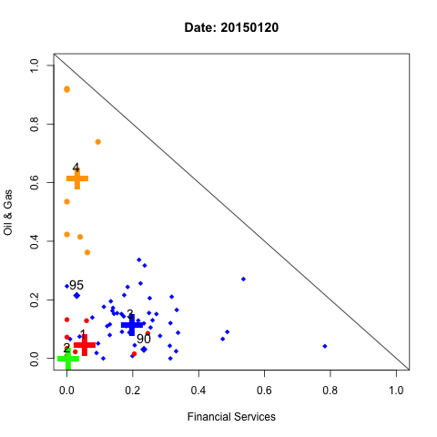
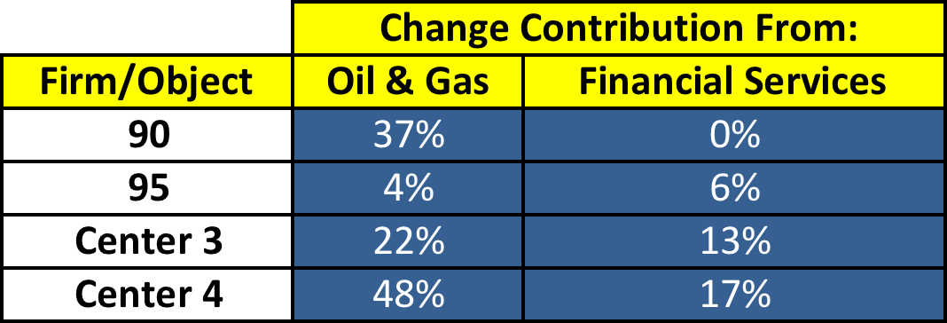
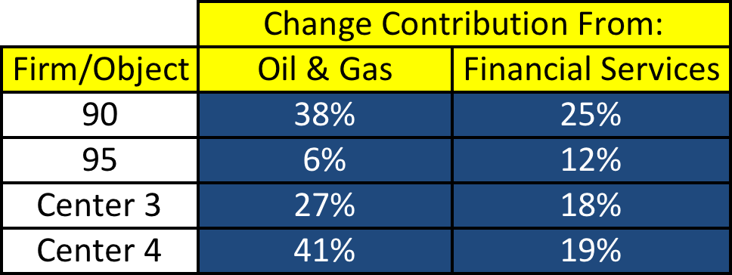

Day 11, 12, and 13
Distance: 0.46
Distance: 0.38
Distance: 0.71

Slide 9
(Hypothesized) Reason For Cluster Swith
On January 19th (12th trading Day of January) firm 90 switched clusters from it’s previous day, and returned to it’s initial cluster the following day. Meanwhile, firm 95 remained in the same cluster the entire time.
The happened, even though the difference in investments between firm 90 and 95 on the day firm 90 switched clusters was minimal.

Slide 10
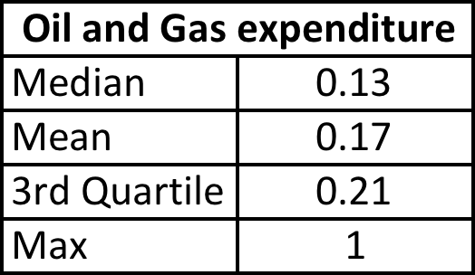
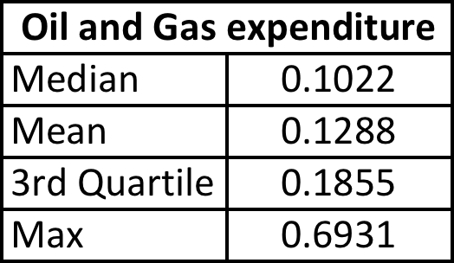
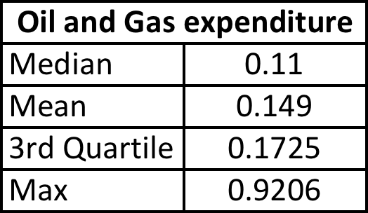
Day 11, 12, and 13

Slide 11
Results
Firms that typically invest a large portion in Oil & Gas tended to decrease that investment on January 19th.
K-means centers are usually very susceptible to extreme values. Once these values became not as extreme, the center moved in and firm 90 switched clusters as a result, even though firm 90’s positions did not change very much (0.11 delta).

Slide 12
Conclusion
Inconclusive. There are many ways and many reasons that a firm may change clusters. Sometime the 2 firms which are usually clustered together can keep the same same location, but the landscape changes cause 2 shift of one of the firms clusters.
Other times the firms might just act differently on the same information.
In general, there are a lot of possibilities and it’s nearly impossible to draw firm conclusions.

Slide 13
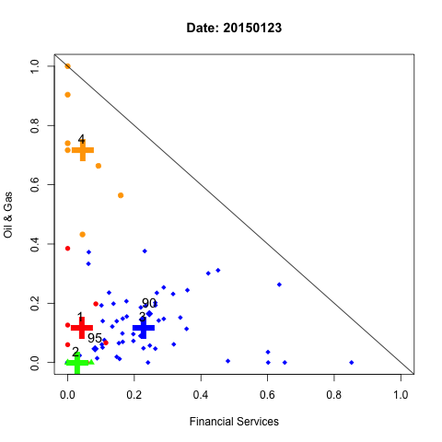
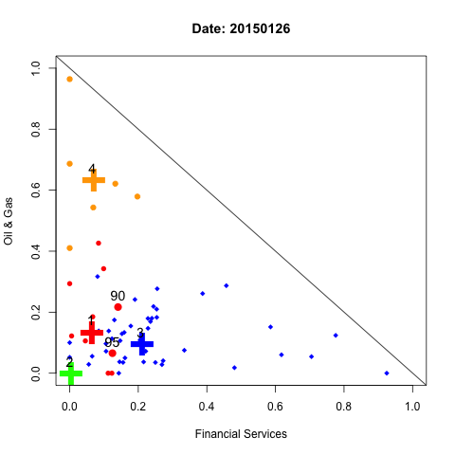
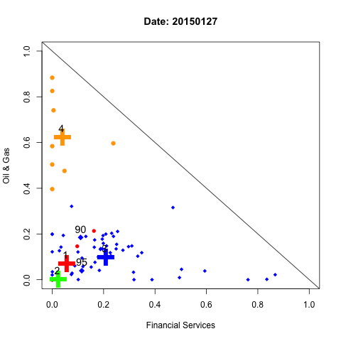
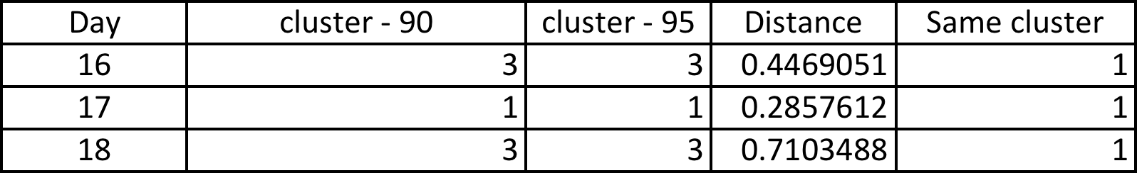
Changing clusters in pairs
- On the 17th trading day of January we saw both firms switch clusters from the previous day, and then rejoin the cluster the following day.

Slide 14
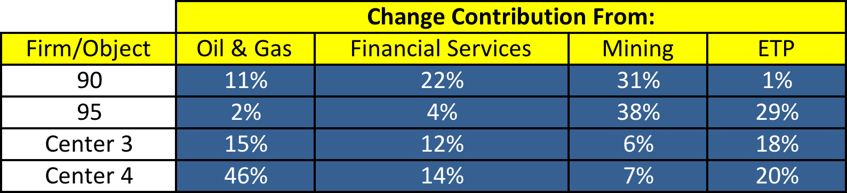
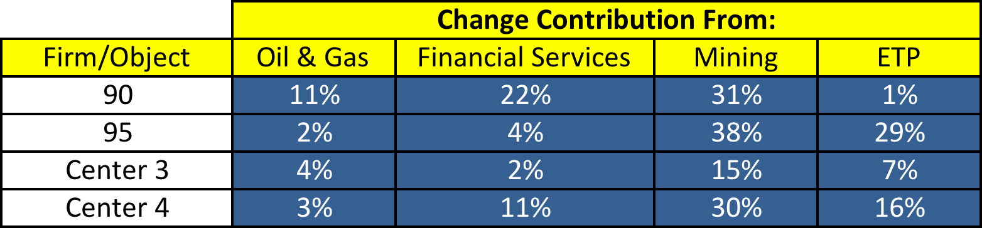
- Might be useful to look at it from an ETP/Mining perspective

Slide 15
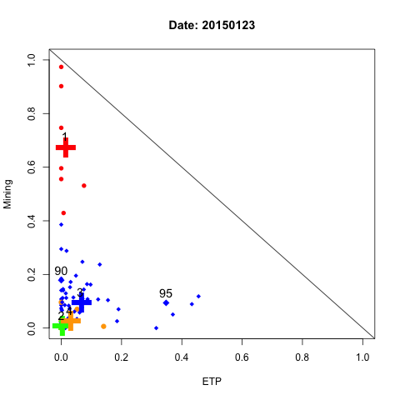
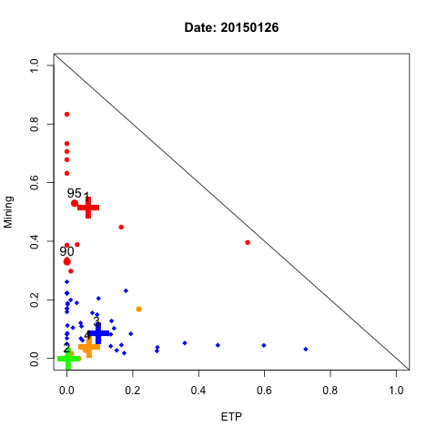
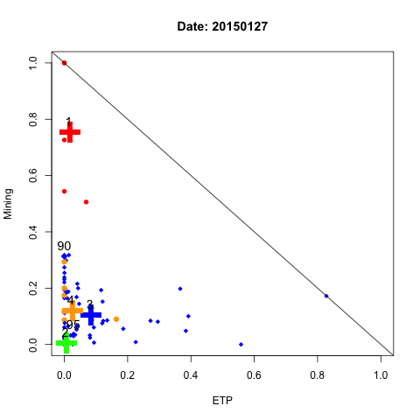
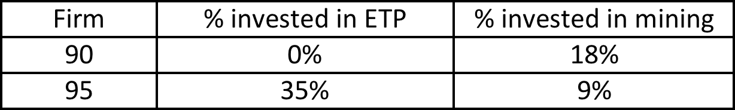
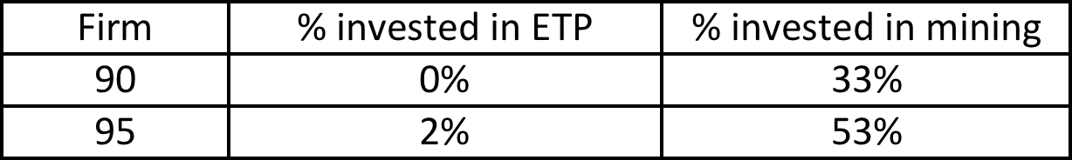
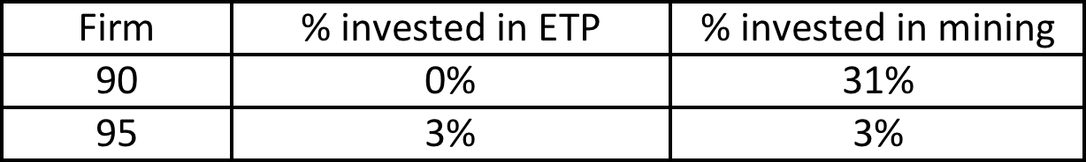
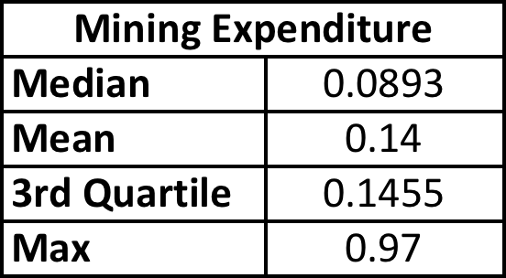
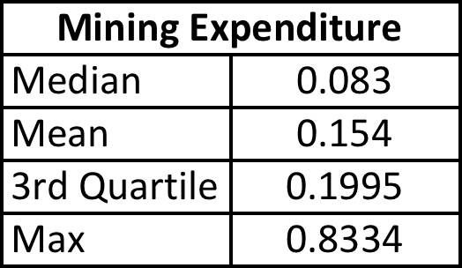
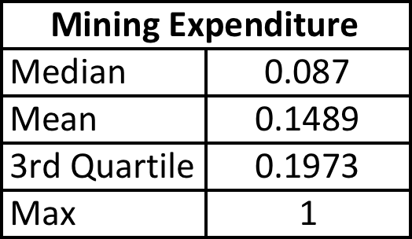
Financial Services and Oil & Gas do a poor time of illustrating the clusters in this case

Slide 16
Results
From day 16 to day 17 there was a large shift in the cluster 1 centroid. This shift was primarily due to firms which usually invest an extremely large portion in Mining, reducing that investment on day 17.
Also on day 17, firm 95 drastically increased there investment in mining, and firm 90 slightly increased there’s.
This led to centroid 1 falling closer to the origin, and firms 90 & 95 moving closer to the centroid causing the change in cluster.

Slide 17
Conclusion
In general, there are 3 main scenarios which could cause erratic behaviour in terms of changing clusters
New information; Firms acting differently based on new information.
Changing statistical landscape; Other firms changing their behaviours, leading to changing center locations.
A combination of the two above, in general it tends to be this case.

